Slide 1
19160-6 for WG meeting
9 December 2019

Slide 2
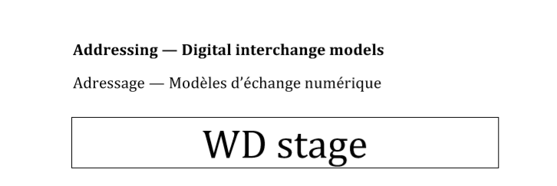
Pt 1 is already our “interchange model”.
All TC211 models are for “Interchange”
Notes:
19160-1 is the consensus model
normalisation of the concepts of addressing
to enable the ambition of interoperability of addresses

Slide 3
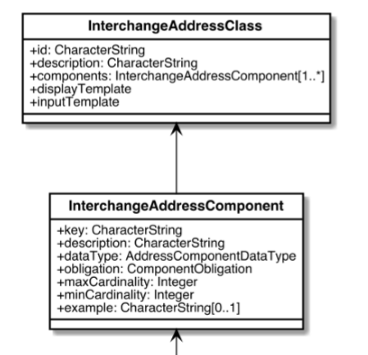
Overlaps AddressSpecification in Part 1
Templates not in Part 1 (see Slide 6)
Notes:
This isn’t a very ‘clean’ model i.e. it is ambiguous
The association from InterchangeAddressComponent is just in one direction to InterchangeAddressClass
Then InterchangeAddressClass also contains InterchangeAddressComponent as a complex data type
What is being attempted here, as far as we can see, is already covered by 19160-1 ( in the AddressSpecification class)

Slide 4
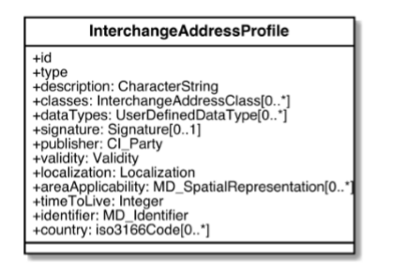
Not Part 1
Material for a Profile Registry?
Notes:
This appears to be metadata about an Address Profile
This is not covered in 19160-1
Perhaps this could be a new standalone model for interchange of Address Profiles ? … interchange of Address registry information perhaps

Slide 5
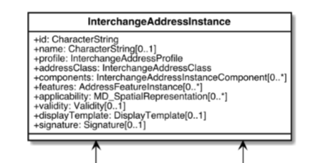
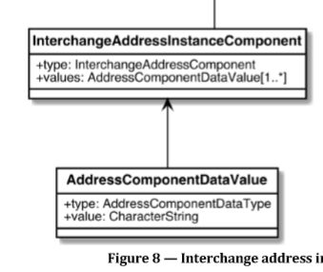
Equivalent to Address and AddressComponent in Part 1
Notes:
Already published in 19160-1 i.e. achieves the same thing

Slide 6
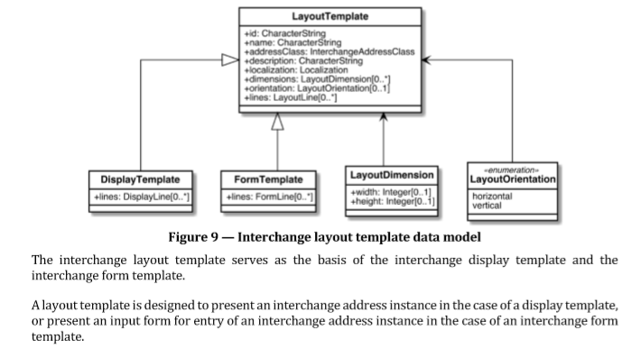
Templates must be Jurisdiction or Application Profile specific.
This could be an Informative Annexe in Part 1.
Notes:
Input and output formats must be jurisdiction specific ( like 19160-4 promotes )
Suggest add an illustrative annex to 19160-1 (next revision) for how to render a local address Profile

Slide 7
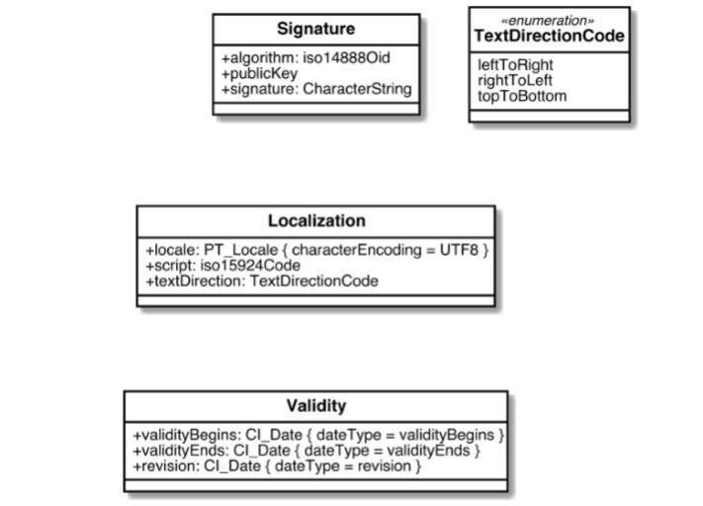
Metadata, could be in Part 1.
Notes:
What is the relationship to interoperating addresses from different Profiles?
It would appear that some of this would be useful in 19160-1 perhaps

Slide 8
Address
Specification
Profile
Registry
New draft standard?
Part 1 already
Add to Part 1
A
Reference
Data
(new)
Address
Component
Address
Addressable
Object
Reference
Object
Missing from Part 6
Templates
(new)
Add Annex to Part 1
Notes:
In Summary
Differences between ISO19160-1 and WD19160-6
Draft 19160-6 seems to be missing provision for AddressableObject and ReferenceObject
There are useful ideas in 19160-6 that could be usefully incorporated into 19160-1
There might be an idea for a new standard? - Profile Registry ?

